Slide 1


Psychopathy
[Professor Name]
[Class and Section Number]
Notes:
Class Recommendations: This module was designed to be taught in one 75-minute class period. For a more involved warm up activity, see Slide 4.
Overview: Psychopathy (or “psychopathic personality”) is a topic that has long fascinated the public at large as well as scientists and clinical practitioners. However, it has also been subject to considerable confusion and scholarly debate over the years. This module reviews alternative conceptions of psychopathy that have been proposed historically, and reviews major instruments currently in use for the assessment of psychopathic tendencies in clinical and nonclinical samples. An integrative theoretic framework, the Triarchic model, is presented that provides a basis for reconciling differing historic conceptions and assessment approaches. Implications of the model for thinking about causal hypotheses of psychopathy, and for resolving longstanding points of contention in the field, are discussed.
Technical Note: These slides may contain simple click animation so that you can focus students’ attention on a particular question, a selection of text, or an image and not have them be distracted by reading ahead. You can either preview the sequence of animation by going through the slides in slideshow view, visiting the animations tab, or reviewing the slide notes. In the notes you will see a cue - (Click) – that corresponds to each animation.
You may also find hyperlinks to outside videos at various places in the slides. These hyperlinks are embedded in text and indicated by color and in the notes section.

Slide 2
Today’s Learning Objectives
Learn about Cleckley’s classic account of psychopathy, presented in his book The Mask of Sanity, along with other historic conceptions.
Compare and contrast differing inventories currently in use for assessing psychopathy in different samples (e.g., adults and younger individuals, within clinical-forensic and community settings).
Become familiar with the Triarchic model of psychopathy and its constituent constructs of boldness, meanness, and disinhibition.
Notes:
Purpose: This slide outlines the learning objectives of the module.

Slide 3
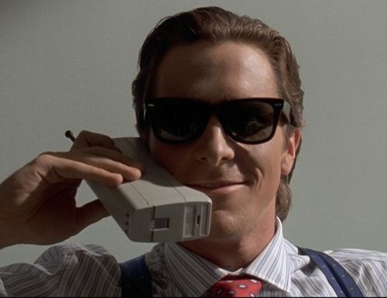
Warm Up: Your Favorite Psychopaths
Name one of your favorite psychopaths from a movie
Why is this character a psychopath? Be specific.
Notes:
This slide is designed to help students begin looking at pop cultural definitions and portrayals of psychopathy and creates a reference point for comparison to the clinical description.
Time: 3-5 minutes
Materials: Something to write or type with, a piece of paper or a laptop/tablet
Directions:
(Click): Name one of your favorite psychopaths from a movie
First, ask students to get out something they to write with and some paper or to open up a blank document on their computer or tablet.
(Click): Why is this character a psychopath? Be specific.
Next, ask students to take a few minutes and think about some of their favorite psychopaths from popular movies. Once they have identified one they like, ask students to write a brief description of why they believe this character is a psychopath. Make sure to remind the students to be as specific as possible in their descriptions. Once finished, ask willing students to share their responses. The purpose is to initiate a discussion around myths, facts, and pop cultural portrayals of psychopathy and how those portrayals are similar or different from the clinical diagnosis.

Slide 4
Overview
Introduction
Historic Conceptions
Contemporary Assessment Methods
Core Ingredients of Psychopathy
Causal Factors
Triarchic Model and Long Debated Issues
Notes:
The purpose of this slide is for the instructor to provide students with an overview of the material that will be covered during the lecture.

Slide 5

Introduction
Dispositional tendencies vs. serious criminal acts
Psychopathy from a clinical scientific perspective
Notes:
The purpose of this slide is to begin discussing the definitions of psychopathy
(Click): Dispositional tendencies vs. serious criminal acts
Now that students have focused on one common representation of psychopathy, begin discussing the difference between dispositional tendencies and serious criminal acts. This will help students to see that psychopathy is more than just serial killers as they will often believe prior to the start of the warm-up activity.
(Click): Psychopathy from a clinical scientific perspective
In this module psychopathy is viewed as a clinical disorder, and the history of the disorder is traced forward until arrival at modern conceptualizations.

Slide 6
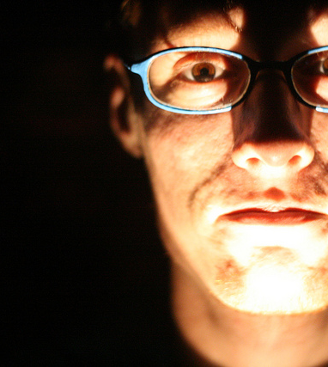
A World Without Empathy
How would your life be if you couldn’t practice empathy?
How might you behave differently?
What consequences would this have?
Notes:
This slide introduces an activity that is designed to help students consider what it might be like to be without empathy and how it might affect their worlds since profound lack of empathy is a major facet of psychopathy.
Time: 5-7 minutes
Materials: N/A
Directions:
(Click): How would your life be different if you could not practice empathy?
First, define the concept of empathy for students. Often students think of it as the ability to put oneself in another’s shoes. Perhaps a more accurate way of thinking about it is the ability to try and feel what it is like for another person in his or her own shoes. Once explained, divide students into small groups of 3-4 and ask them to take 3-5 minutes to consider the following questions:
(Click): How might you behave differently?
(Click): What consequences would this have for the world around you?
Once completed, process with the entire class how they answered the questions in their groups. An effective way to conclude the activity can include reminding students that it is believed those with psychopathy are likely born with an inability to practice empathy.

Slide 7
Overview
Introduction
Historic Conceptions
Contemporary Assessment Methods
Core Ingredients of Psychopathy
Causal Factors
Triarchic Model and Long Debated Issues
Notes:
The purpose of this slide is for the instructor to indicate to the students that the lecture is moving forward to the next content topic.

Slide 8
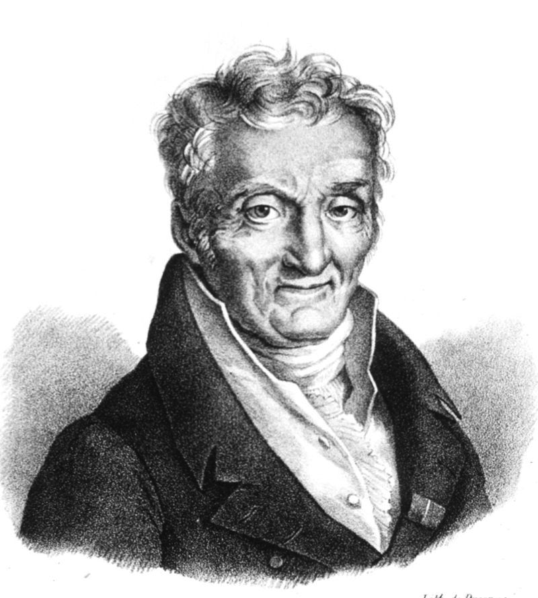
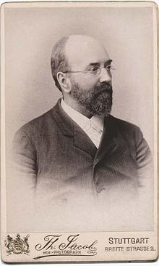
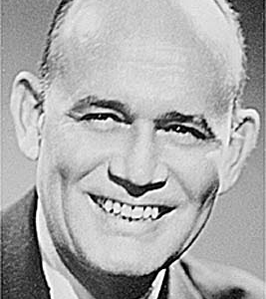
Historic Conceptions
Phillipe Pinel
manie sans delire
Julius Koch
Introduced the term psychopathic
Hervey Cleckley
The Mask of Sanity
Emotional pathology doesn’t match outward appearance
16 diagnostic criteria
Antisocial Personality Disorder replaces Psychopathy in DSM
Notes:
The purpose of this slide is to give students a brief history of psychopathy’s most important contributors.
(Click): Philippe Pinel
(Click): manie sans delire
Philippe Pinel (1745-1826), a French physician, wrote case reports of what he called manie sans delire (“insanity without delirium”) where people engaged in dramatic incidences of recklessness and aggression.
(Click): Julius Koch
Julius Koch (1888), was a German psychiatrist, who introduced the term „psychopathic“.
(Click): Hervey Cleckley
Hervey Cleckley (1941-1976) was an American psychiatrist who provided a new conceptualization of psychopathy.
(Click): The Mask of Sanity
Cleckley published a book on psychopathy in 1976 in which he outlined that -
(Click): Emotional pathology doesn’t match outward appearance
Cleckley described psychopaths as having an outward appearance of good mental health that belied a deep emotional pathology.
(Click): 16 diagnostic criteria
His case studies led him to develop 16 diagnostic criteria to assist in the identification of individuals with psychopathy.
In contrast to those who came before him, Cleckley noted that those with psychopathy were not violent or dangerous, but rather, had a nonphysical and impulsive self-centeredness.
(Click): Antisocial Personality Disorder replaces Psychopathy in the DSM
Cleckley’s description of psychopathy was used as the foundation for the diagnosis of psychopathy in the first two iterations of the DSM. Psychopathy as a diagnosis was later replaced by antisocial personality disorder in the third iteration of the DSM and still remains, albeit with a few additions, in the current edition of the manual.

Slide 9
Overview
Introduction
Historic Conceptions
Contemporary Assessment Methods
Core Ingredients of Psychopathy
Causal Factors
Triarchic Model and Long Debated Issues
Notes:
The purpose of this slide is for the instructor to indicate to the students that the lecture is moving forward to the next content topic.

Slide 10
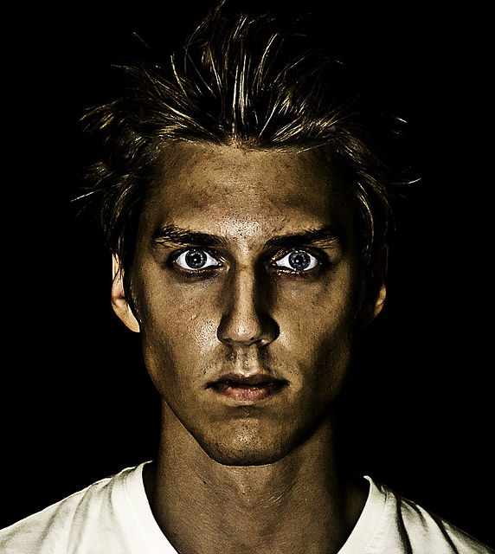
Contemporary Assessment Methods
Psychopathy in Criminal Adults
Psychopathy Checklist Revised (PCL-R)
Psychopathy in Noncriminal Adults
Psychopathic Personality Inventory-Revised (PPI-R)
Psychopathy in Children and Adults
Antisocial Process Screening Device (APSD)
Notes:
The purpose of this slide is to distinguish between the various populations and modalities of assessment of psychopathy.
(Click): Psychopathy in adult criminal offenders:
(Click): Psychopathy Checklist Revised (PCL-R)
The most commonly used assessment for adult criminal offenders is the Psychopathy Checklist-Revised (PCL-R). This assessment consists of 20 items that are rated based on an interview and file-record information. This checklist covers the deviant behavior and interpersonal-affective deficits classified by Cleckley as well as limited positive adjustment features. If one scores at least 30 out of 40 on the measure, a diagnosis of psychopathy can be made. High scores are correlated with impulsive and aggressiveness issues, low empathy, Machiavellianism, lack of social connectedness, and persistent violent offending.
(Click): Psychopathy in noncriminal adults:
(Click): Psychopathic Personality Inventory-Revised (PPI-R)
Psychopathy has been most frequently measured in non-offending adult populations. Modern measures for this population such as the Psychopathic Personality Inventory-Revised (PPI-R), measure both antisocial deviancy and interpersonal affective features. The PPI-R has 154 items which are divided into eight scales and looks at sub-factors of two general factors: fearless dominance (FD) and self-centered impulsivity (SCI).
(Click): Psychopathy in child and adolescent clinical samples:
(Click): Antisocial Process Screening Device (ASPD)
Antisocial Process Screening Device (APSD) is one of the most extensively researched measures of psychopathic tendencies in youth aged 6-13. The assessment contains 20 items that are completed by both teachers and parents and focused on two general factors: Callous-Unemotional (CU) and Impulsive/Conduct Problems (I/CP).

Slide 11
Psychopathy For The Rich and Famous
Identify a celebrity or television character that has a “big personality”
Psychopath Test
Now take the assessment as if you were the character you identified. What did you find?
Notes:
This slide introduces an activity that is designed to help students get a rudimentary introduction to the assessment of psychopathy.
Time: 5-10 minutes
Materials: A device that has access to the internet and a web browser. This activity can also be performed at home if you don’t have access to computers in your classroom
Directions: The activity can be done in class if all students have access to a device connected to the internet and a web browser, by the instructor as a large group on a computer connected to the classroom projector, or students can be encouraged to complete the activity at home and discuss next class period.
(Click): Identify a celebrity or television character that has a “big personality”
Once it has been decided by the instructor which of the three aforementioned approaches is best for their classroom, ask students (or decide as a group) to identify one celebrity or television/movie character of their choosing and inform students that they will pretend to be this person as they complete the assessment. It can be good to nudge the students in a direction of a person who has at least some qualities that will likely show up on a measure of psychopathy (lack of empathy, feelings of superiority, past criminal indiscretions, etc.).
(Click): Next, open up the following link (THE TEXT OF THIS MIGHT CHANGE)
Next, go to the following website: http://vistriai.com/psychopathtest/
(Click): Now take the assessment as if you were the character you identified. What did you find?
After the assessment has been completed, process the results with the students. Make sure to remind the students that this assessment is based off of the PCL-R, but that it is not the actual assessment.
Caution: Some students may feel mildly uncomfortable with this activity because it can be interpreted as "judging another person." You may want to emphasize to students that this activity is not about morally condemning another person or suggesting that they do not have worth. In fact, the class' assessments of celebrity psychopathy may or may not even be accurate. Instead, this exercise simply uses a public figure as a vehicle for better understanding the features of psychopathy.

Slide 12
Overview
Introduction
Historic Conceptions
Contemporary Assessment Methods
Core Ingredients of Psychopathy
Causal Factors
Triarchic Model and Long Debated Issues
Notes:
The purpose of this slide is for the instructor to indicate to the students that the lecture is moving forward to the next content topic.

Slide 13
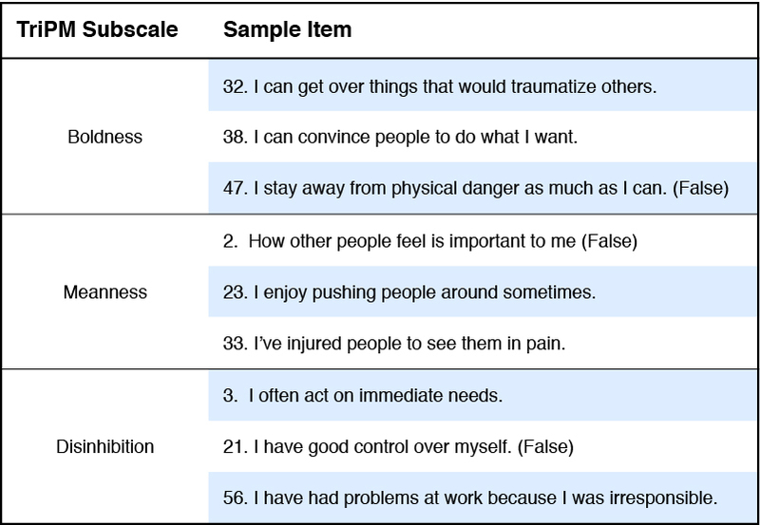
Core Ingredients of Psychopathy
Notes:
This slide highlights the Triarchic Model, which is a crucial model in the modern conceptualization of psychopathy that sought to reconcile previous models. Making sure students understand the three core elements – disinhibition, meanness, and boldness – is the primary objective.
The Triarchic model is a recent attempt to reconcile alternative perspectives to understanding psychopathy that consists of the following three components:
Disinhibition: impulsiveness, hostility, trouble regulating emotion
Disinhibition as characterized by impulsiveness, weak behavioral restraint, hostility and mistrust, and trouble regulating emotion.
Meanness: lack of empathy, contempt, predatory exploitativeness
Meanness as evidenced by lack of empathy, lack of affiliative capacity, contempt toward others, predatory exploitativeness, and empowerment through cruelty and destructiveness
Boldness: dominance, social assurance, venturesomeness
Boldness as demonstrated by dominance, social assurance, emotional resiliency, and venturesomeness.
From the perspective of the Triacrhic model, Cleckley’s conceptualization focused primarily on boldness and disinhibition. As such, people high in disinhibitory tendencies would qualify for a diagnosis of psychopathy if they also scored high on boldness, meanness, or both, but not if they scored high on only one of the aforementioned tendencies.
Source:
Patrick, C. J. (2010). Operationalizing the Triarchic conceptualization of psychopathy: Preliminary description of brief scales for assessment of boldness, meanness, and disinhibition. Unpublished test manual, Florida State University, Tallahassee, FL. Retrieved from https://www.phenxtoolkit.org/index.php?pageLink=browse.protocoldetails&id=121601

Slide 14
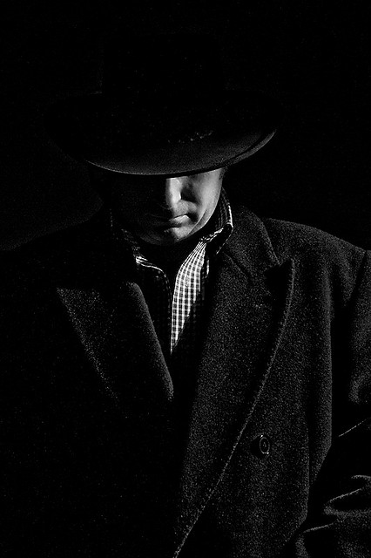
Core Ingredients of Psychopathy
The Triarchic Psychopathy Measure (TriPM)
Finalized in 2010
58 items on three subscales
Translated into several languages
Early validity data are encouraging
Notes:
This slide looks at the Triacrhic Psychopathy Measure (TriPM) which was designed as way to operationalize the Triarchic model.
The Triarchic Psychopathy Measure (TriPM)
(Click): Finalized in 2010
(Click): 58 items on three subscales
(Click): Translated into several languages
(Click): Early validity data are encouraging
The TriPM, a relatively new measure finalized in 2010, contains 58 items on three subscales (See Table 1 on page 71 of the IM Module for more). This assessment has been translated into several languages and additional validity data are being compiled, but the early returns are promising.

Slide 15
Overview
Introduction
Historic Conceptions
Contemporary Assessment Methods
Core Ingredients of Psychopathy
Causal Factors
Triarchic Model and Long Debated Issues
Notes:
The purpose of this slide is for the instructor to indicate to the students that the lecture is moving forward to the next content topic.

Slide 16
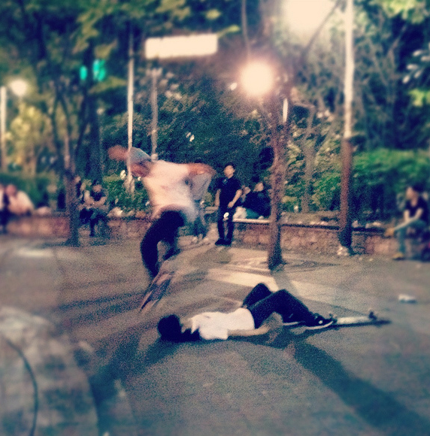
Causal Factors
Core Deficits
Emotional Sensitivity
Responsiveness
Individuals have a lack of defensiveness or fear reactivity
Notes:
This slide is intended to introduce students to neurobiology findings in the area of psychopathy.
(Click): Core deficits in emotional sensitivity and responsiveness
(Click): Research on those with psychopathy shows that these individuals have a lack of normal defensiveness or fear reactivity
One of the most consistent findings in those believed to have psychopathy is a lack of normal enhancement of the startle blink reflex to abrupt noises while viewing something aversive in the foreground (e.g. scary or disturbing pictures) as compared to neutral stimuli. This finding suggests a lack of normal defensiveness (fear) reactivity.

Slide 17
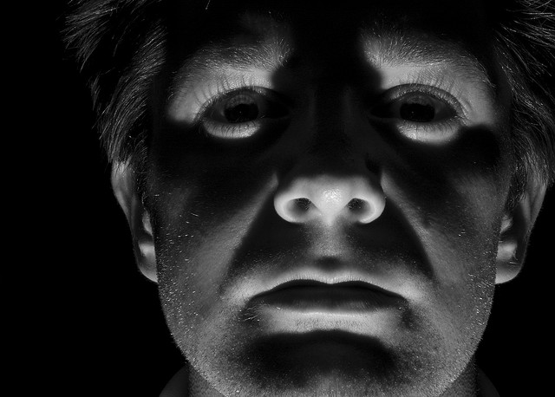
Causal Factors
Impairments in
Cognitive-attentional processing
Deficits in
Cognitive performance
Amygdala reactivity
Notes:
The purpose of this slide is to discuss impairments of psychopathic individuals in cognitive attentional processing.
(Click): Impairments in cognitive-attentional processing
(Click): Deficits in cognitive performance and amygdala reactivity to distress cues have been found in psychopathic individuals
Impaired action monitoring or deficits on cognitive performance tasks has been a consistent finding of those with psychopathy. In addition, high-psychopathic individuals demonstrate deficits in amygdala reactivity to distress cues.

Slide 18
Overview
Introduction
Historic Conceptions
Contemporary Assessment Methods
Core Ingredients of Psychopathy
Causal Factors
Triarchic Model and Long Debated Issues
Notes:
The purpose of this slide is for the instructor to indicate to the students that the lecture is moving forward to the next content topic.

Slide 19
Triarchic Model and Long Debated Issues
Can psychopathy be adaptive?
Is lack of anxiety a feature of psychopathy?
Do violent and aggressive tendencies have to be present in psychopaths?
Must antisocial behavior exist for one to be diagnosed with psychopathy?
Do different subtypes of psychopathy exist?
Notes:
This slide introduces students to five of the first seven long debated issues in the history of psychopathy.
(Click): Can psychopathy be adaptive?
Cleckley’s model of psychopathy accounted for positive adjustment in people with psychopathy whereas prominent assessments such as the PCL-R did not and instead focused largely on deviancy. The Triarchic model accounts for more adaptive elements in its boldness scale.
(Click): Is lack of anxiety a feature of psychopathy?
There is disagreement with regard to lack of anxiety as a feature of psychopathy as Cleckley most prominently proposed since research from the PCL-R and other measures have found a positive association between anxiety and psychopathy. The Triacrhic model addresses these inconsistent findings by separating psychopathy into subcomponents that relate differently to measures of trait anxiety.
(Click): Do violent and aggressive tendencies have to be present in psychopaths?
Violent and aggressive tendencies are yet another area of disagreement with Cleckley calling these tendencies “the exception rather than the rule.” However, further research conducted by proponents of the Triarchic model have found something similar with only a certain subset of those with psychopathy who score higher on boldness as well as disinhibition.
(Click): Must antisocial behavior exist for one to be diagnosed with psychopathy?
Antisocial behavior is another area of debate. The Triarchic model suggests antisocial behavior rises from the complex interplay of “deviance promoting” influences such as dispositional boldness, meanness, and disinhibition.
(Click): Do different subtypes of psychopathy exist?
Another important question is do different subtypes of psychopathy exist? The Triacrhic model relies on a pattern of differing configurations (e.g. bold-disinhibited). This raises complicated questions about whether all subtypes are equally deserving of psychopathic diagnoses.

Slide 20
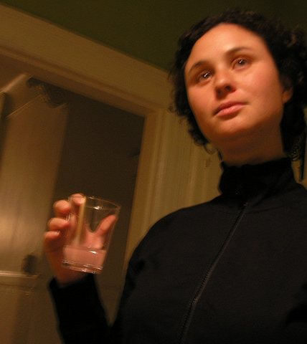
Triarchic Model and Long Debated Issues
Are there sex and gender differences in psychopathy?
Do “successful” psychopaths exist?
U.S. presidents with higher scores on boldness performed better
Notes:
This slide continues with long debated issues number six and seven.
(Click): Are there sex and gender differences in psychopathy?
Another interesting question is whether or not there are sex and gender differences in the presentation of psychopathy. Cleckley held the view that psychopathy could and did exist in both women and men and presents with the same core deficits. However, more recent research shows that men tend to score higher on measures of psychopathy than women as well as scoring differently on the subscales of the Triarchic model.
(Click): Do successful psychopaths exist?
(Click): Research shows that U.S. presidents who had higher estimated scores on boldness performed better than those who scored higher on self-centered impulsivity.
Some research shows that people score higher on dispositional fearlessness (boldness) may be more successful when also scoring low on externalizing proneness (disinhibition). A recent study of asked expert historians to estimate scores of past U.S. presidents on the FD and SCI factors of the PPI. Results showed that that those presidents with higher estimated levels of PPI-FD (boldness) performed better whereas those with higher estimated levels of SCI did not.

Slide 21

CAT: Focused Listing
Write a list of important words, concepts, or terms that relate to the term Psychopathy
List as many words as you can that relate to this term in the next 3 minutes
Notes:
CAT: Focused Listing
The activity on this slide focuses on one concept or term from the module and students are asked to provide a list of several ideas that are closely related to the original concept or term. It helps to determine what students are remembering as the most pertinent points related to the given concept or term.
Focus the students’ attention on the word psychopathy. Next, ask them to write down as many related words, terms, or concepts they can remember from the day’s lecture in the ensuing three minutes. The responses of the students can be processed before the class period ends or at the start of the next class period if desired.
If you do not conclude with this Classroom Assessment Technique (CAT), it would helpful to use another CAT. It could be in the form of a:
Muddy point
One-minute paper
Background knowledge
What’s the Principle?
Defining features Matrix:
For more information on CATs click here: http://cft.vanderbilt.edu/guides-sub-pages/cats/

Slide 22
Photo Attribution
Slide 1 | Photo Credit: face geralt https://pixabay.com/en/face-man-silhouette-question-mark-358185/ https://creativecommons.org/publicdomain/zero/1.0/deed.en
Slide 3 | Photo Credit: the-eye-of-faith--american-psycho-1pv1o0hmx-228141-500-385 xakirzat https://www.flickr.com/photos/germani/6851331155 https://creativecommons.org/licenses/by-nc-sa/2.0/
Slide 5 | Photo Credit: head geralt https://pixabay.com/en/head-face-silhouette-clock-time-70184/ https://creativecommons.org/publicdomain/zero/1.0/deed.en
Slide 6 | Photo Credit: flashlight face 1 Serena Epstein https://www.flickr.com/photos/serenae/5196563496 https://creativecommons.org/licenses/by-nc-sa/2.0/
Slide 8 | Photo Credit: French psychiatrist Philippe Pinel (1745-1826) Julien-Leopold Boilly https://en.wikipedia.org/wiki/Philippe_Pinel#/media/File:Philippe_Pinel.jpg Public Domain Photo Credit: Julius Koch anonymous/unknown https://en.wikipedia.org/wiki/Julius_Ludwig_August_Koch#/media/File:Julius_Ludwig_August_Koch.JPG Public Domain Photo Credit: 02 Dr. Hervey Milton Cleckley Image Editor https://www.flickr.com/photos/11304375@N07/3080055527 https://creativecommons.org/licenses/by/2.0/
Slide 10 | Photo Credit: 7/365 - The Wax Statue Andrés Þór https://www.flickr.com/photos/9910344@N05/3832275102/ https://creativecommons.org/licenses/by-nc-sa/2.0/
Slide 14 | Photo Credit: Shadowy Figure Dom W https://www.flickr.com/photos/dom_w/3203628316 https://creativecommons.org/licenses/by-nc-nd/2.0/
Slide 16 | Photo Credit: Bravery Chelsea Marie Hicks https://www.flickr.com/photos/27284887@N03/7150934325/ https://creativecommons.org/licenses/by/2.0/
Notes:
Photo Attribution Slide

Slide 23
Photo Attribution
Slide 17 | Photo Credit: 6.1 j. cliss https://www.flickr.com/photos/pro365ject/542507354 https://creativecommons.org/licenses/by-nc-nd/2.0/
Slide 20 | Photo Credit: really. Jo Guldi https://www.flickr.com/photos/55573153@N00/161531944/ https://creativecommons.org/licenses/by/2.0/
Slide 21 | Photo Credit: Illustrated silhouette of a black cat nehtaeh79 http://www.freestockphotos.biz/stockphoto/16624 http://creativecommons.org/publicdomain/zero/1.0/
Notes:
Photo Attribution Slide

